Slide 1
Skin Cancer Detection
Benign or malignant?

Slide 2

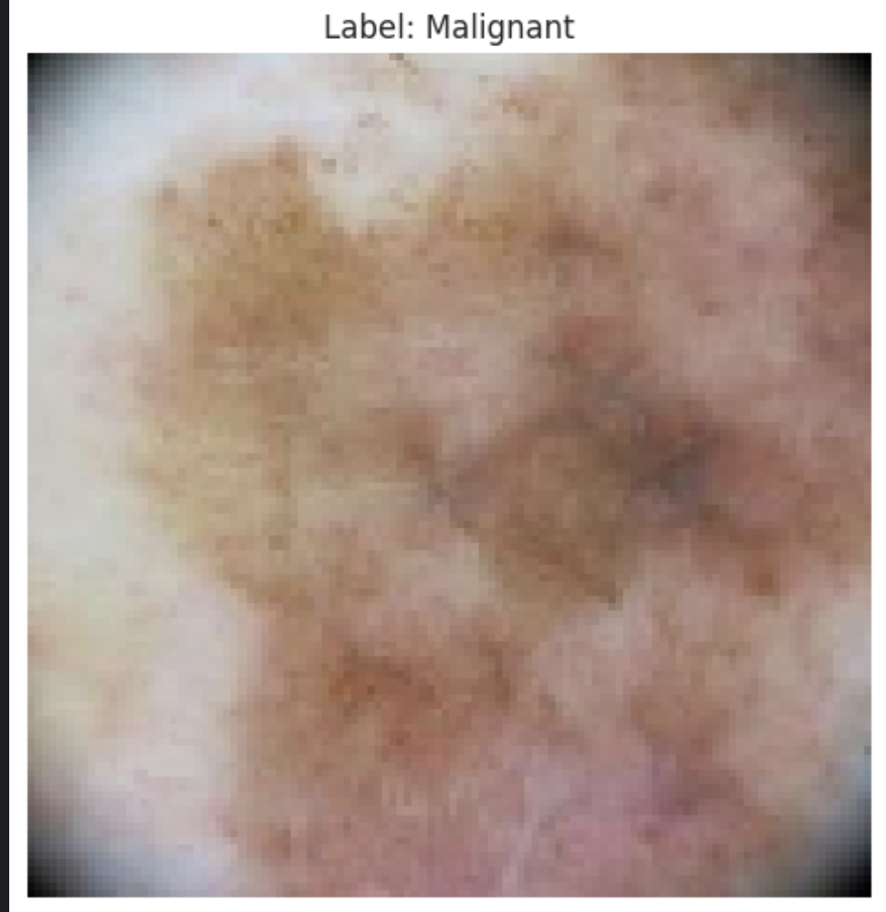
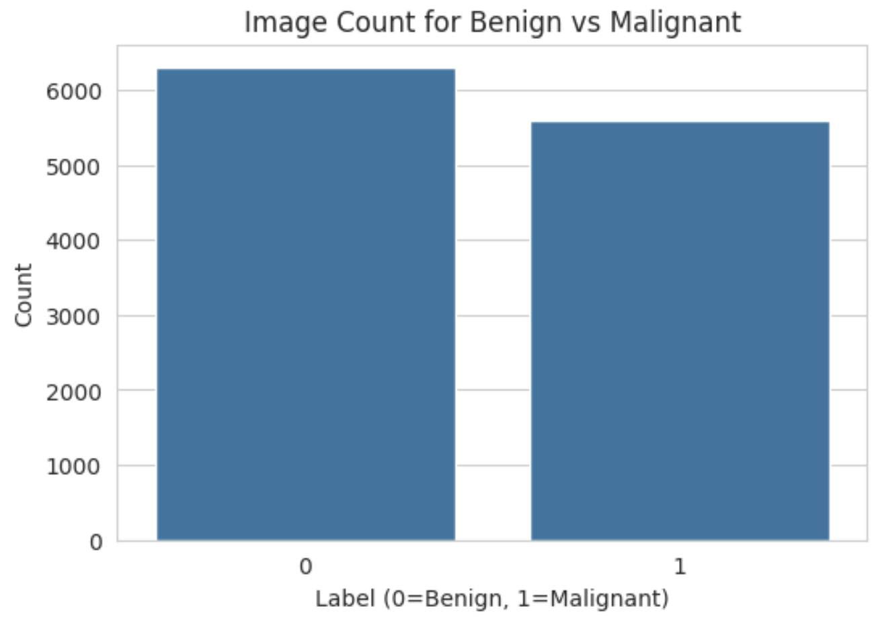
What Is The Goal?
In this project we attempted to predict whether an image of a lesion was reflecting a Benign or a Malignant.
We used a dataset of 11897 images –
47.06 – represented malignant
52.94 – represented benign
2000 images were for testing and the rest for training.
The test was 50% malignant, 50% benign.
Notes:
בפרויקט ניסינו לחזות האם תמונה של פצע מייצגת משהו שפירי או ממאיר (כלומר לא מסוכן או מסוכן)
כדי לבנות את המודל התבססנו על תמונות בגודל
224x224
חילקנו את הדאטה שלנו לטריין וטסט כך ששמרנו 2000 תמונות לטסט (50/50) והשאר לטריין
בסהכ עבדנו על דאטה סט שכולל 11897 תמונות שמתחלקות 47.06 ו52.94 לטובת השפירי

Slide 3
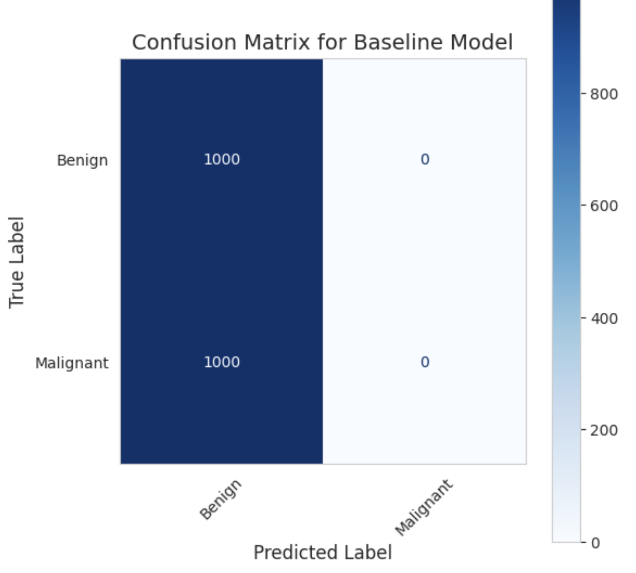
Baseline Model
This model does not rely on any features or patterns from the images, it simply assumes that predicting
the majority class will yield the highest accuracy in the absence of additional insights.
Let’s see the confusion matrix:
The simplest model – we took the majority class as the default predicting for all the images in the train.

Slide 4
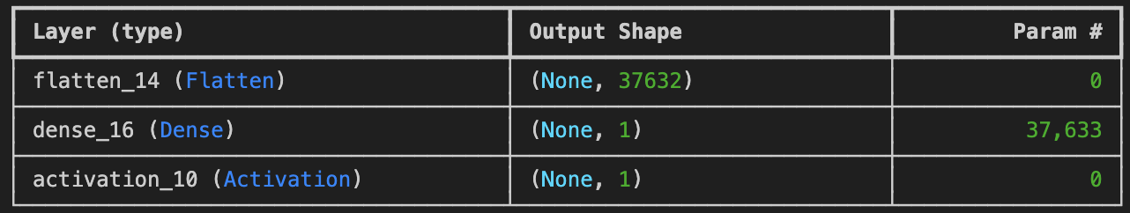
Logistic Regression Model
We built a logistic regression model for binary classification to predict if a sample is "Malignant" or "Benign." It includes a Flatten layer to convert input to 1D, a Dense layer with 37,633 parameters for feature weighting, and a Sigmoid activation layer to output probabilities for classification.
Notes:
We built a logistic regression model designed for binary classification to predict whether a sample is "Malignant" or "Benign." The model consists of three main components: a Flatten layer, which transforms 3D input data into a 1D vector; a Dense layer with a single neuron that computes a weighted sum of the input features; and an Activation layer, which applies the Sigmoid function to output a probability between 0 and 1. This probability determines the class: close to 0 indicates "Benign," and close to 1 indicates "Malignant." The model includes 37,633 parameters, all within the Dense layer, as the Flatten and Activation layers do not require parameters.

Slide 5

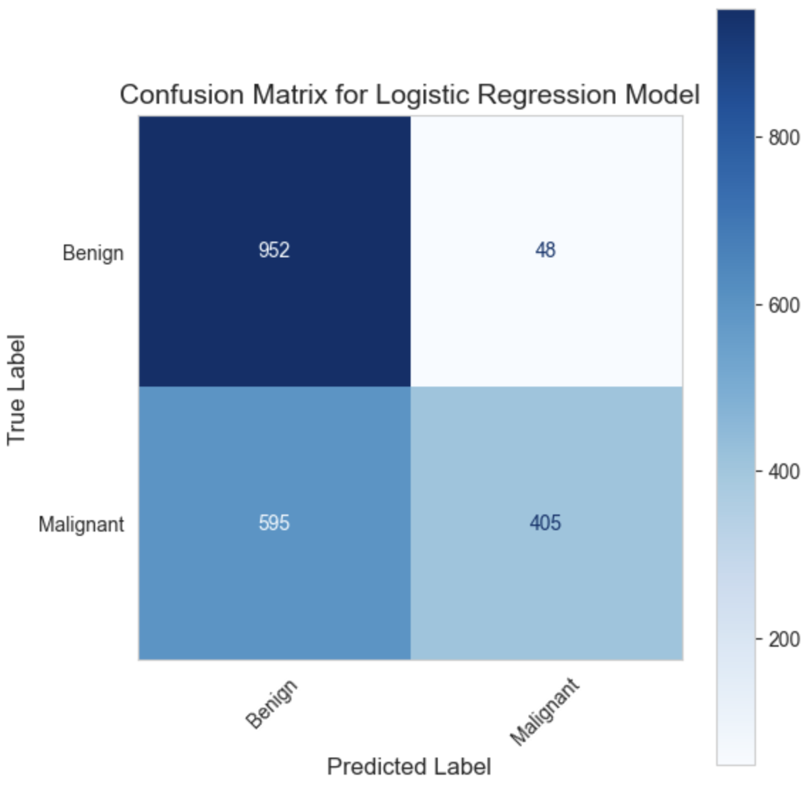
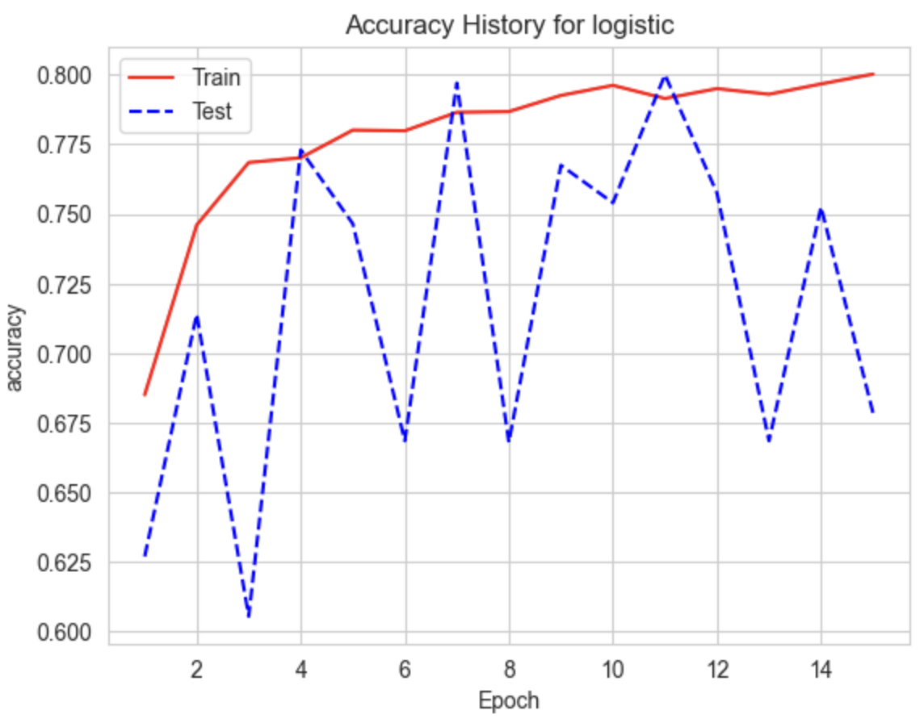



The results:

Slide 6
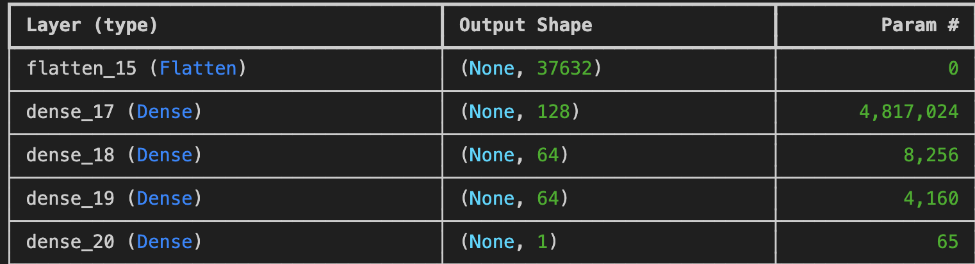
NN Model
The neural network consists of a Flatten layer, three Dense layers, and an output layer. The Flatten layer reshapes 3D input into a 1D vector. The Dense layers, with neuron counts [128, 64, 64], use ReLU activation to learn complex patterns, while the output layer uses Sigmoid activation for binary classification ("malignant" or "benign"). The model is optimized with the Adam optimizer and a learning rate of 0.0001, using binary cross-entropy loss. It includes a total of 4,829,505 parameters, most of which come from the first Dense layer.
Notes:
The neural network model consists of a Flatten layer, three Dense layers, and an output layer, designed for binary classification tasks. The Flatten layer reshapes 3D input data into a 1D vector, preparing it for further processing. The Dense layers, with [128, 64, 64] neurons respectively, use ReLU activation functions to capture complex patterns and high-level relationships in the data. The output layer includes a single neuron with a Sigmoid activation function, which outputs a probability between 0 and 1 to classify the input as "malignant" or "benign."
The model is optimized using the Adam optimizer with a low learning rate of 0.0001 and binary cross-entropy as the loss function, which is well-suited for binary classification. It tracks accuracy during training to evaluate performance. The model has 4,829,505 total parameters, with the majority (4,817,024) residing in the first Dense layer due to the high number of neurons and input connections.

Slide 7
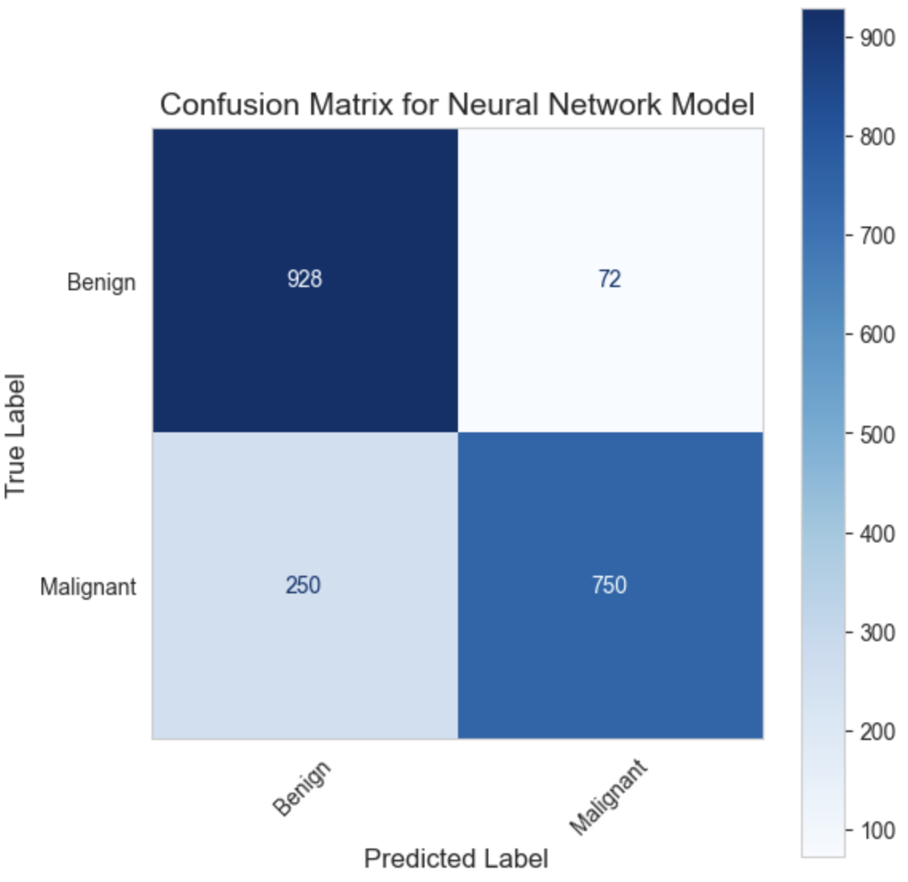
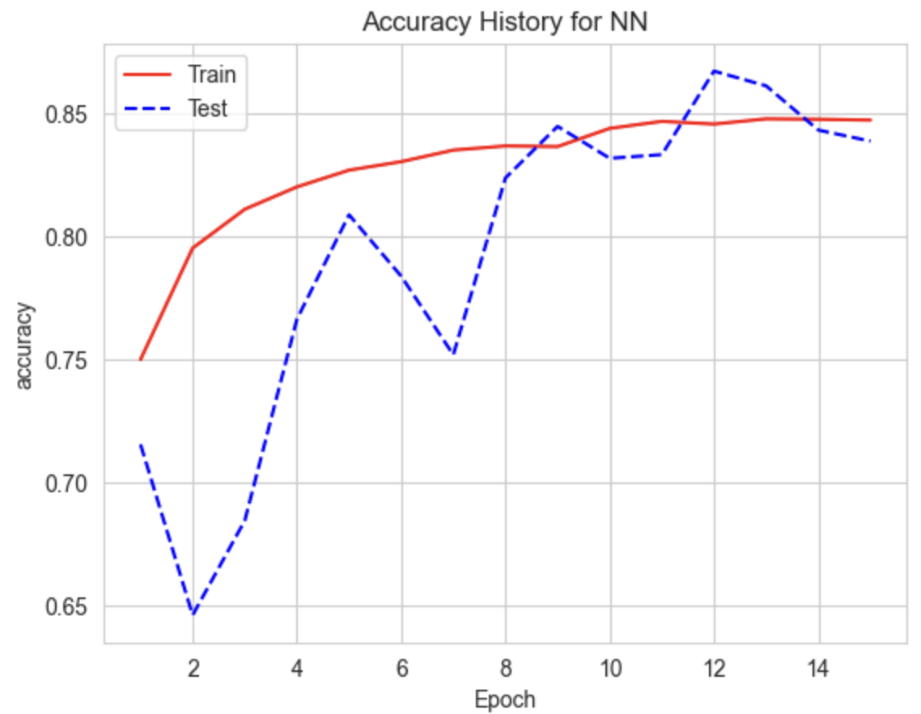
The results:

Slide 8
CNN Model
We developed a Convolutional Neural Network (CNN) for binary classification tasks. The model begins with a convolutional layer (64 filters, 3x3 kernel) to extract basic features like edges, followed by max-pooling to reduce data size and prevent overfitting. Two additional convolutional layers (128 and 256 filters) detect more complex patterns, using batch normalization and max-pooling to enhance stability and efficiency. A Flatten layer then reshapes the data into 1D for the fully connected Dense layer with 256 neurons, followed by a Sigmoid output layer for classification. Optimization is done with Adam, binary cross-entropy loss, and early stopping to prevent overfitting.
Notes:
The CNN starts with a convolutional layer (64 filters, 3x3) for basic feature extraction and max-pooling to down-sample and reduce overfitting. Two additional convolutional layers (128, 256 filters) capture complex patterns, using batch normalization and max-pooling for improved stability and efficiency. After the Flatten layer converts the 2D data to 1D, the Dense layer (256 neurons) learns high-level relationships, followed by a Sigmoid output layer for binary classification. The model is trained with Adam optimizer, binary cross-entropy loss, and early stopping to avoid overfitting during training.

Slide 9
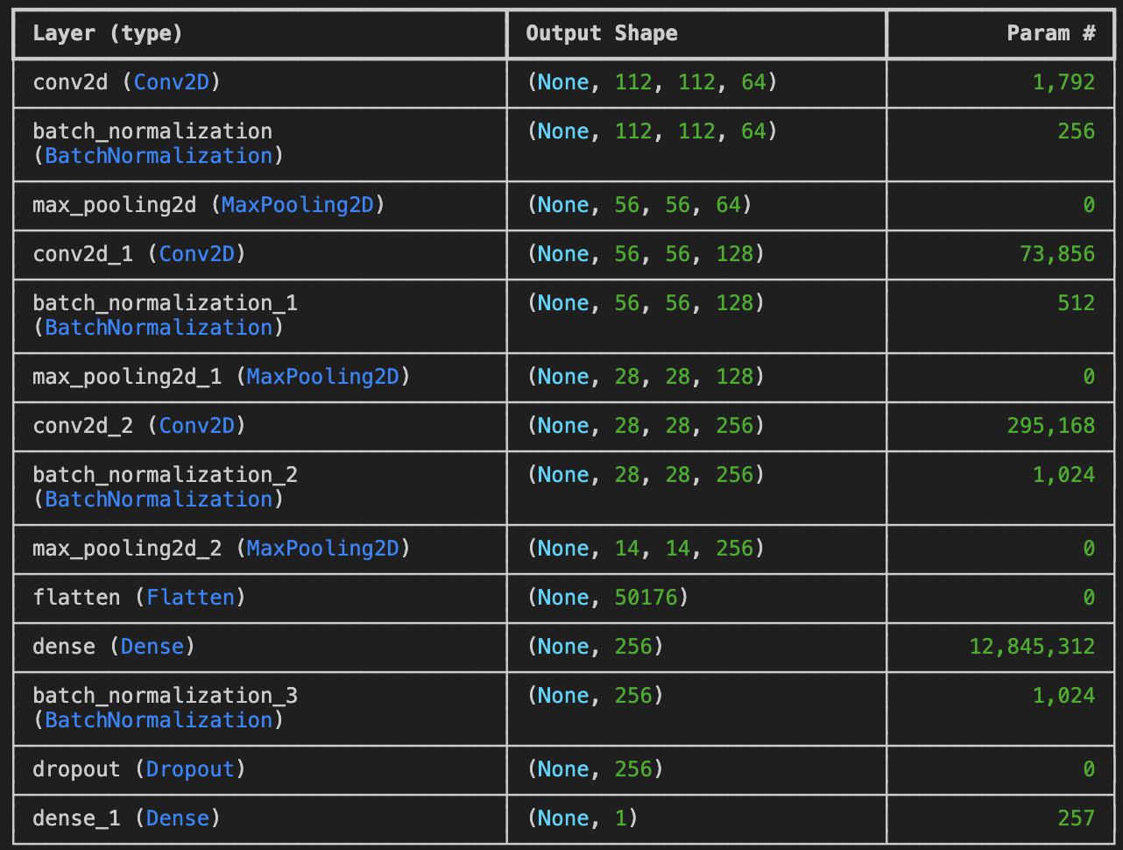

Slide 10
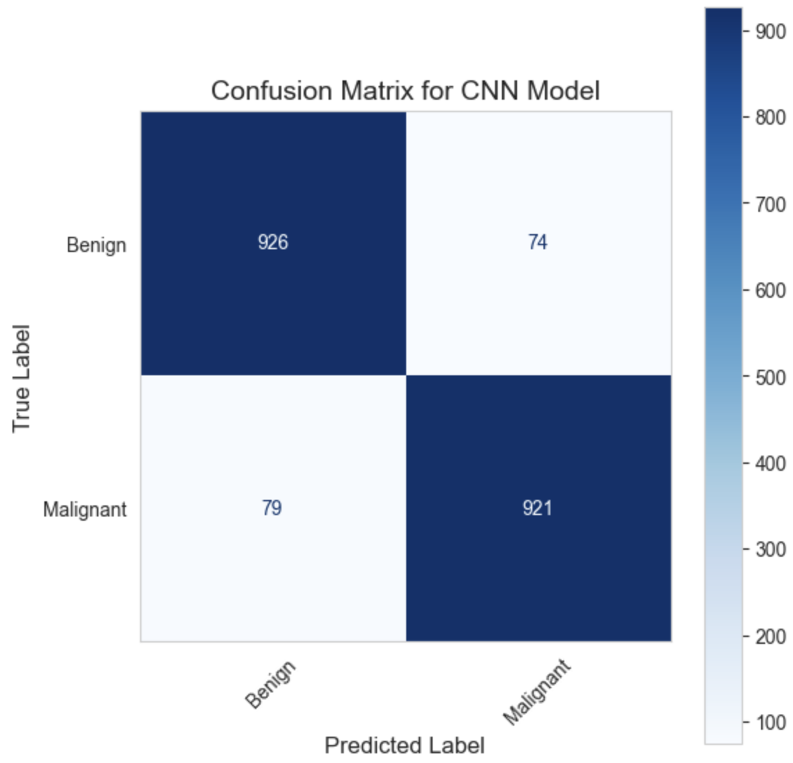
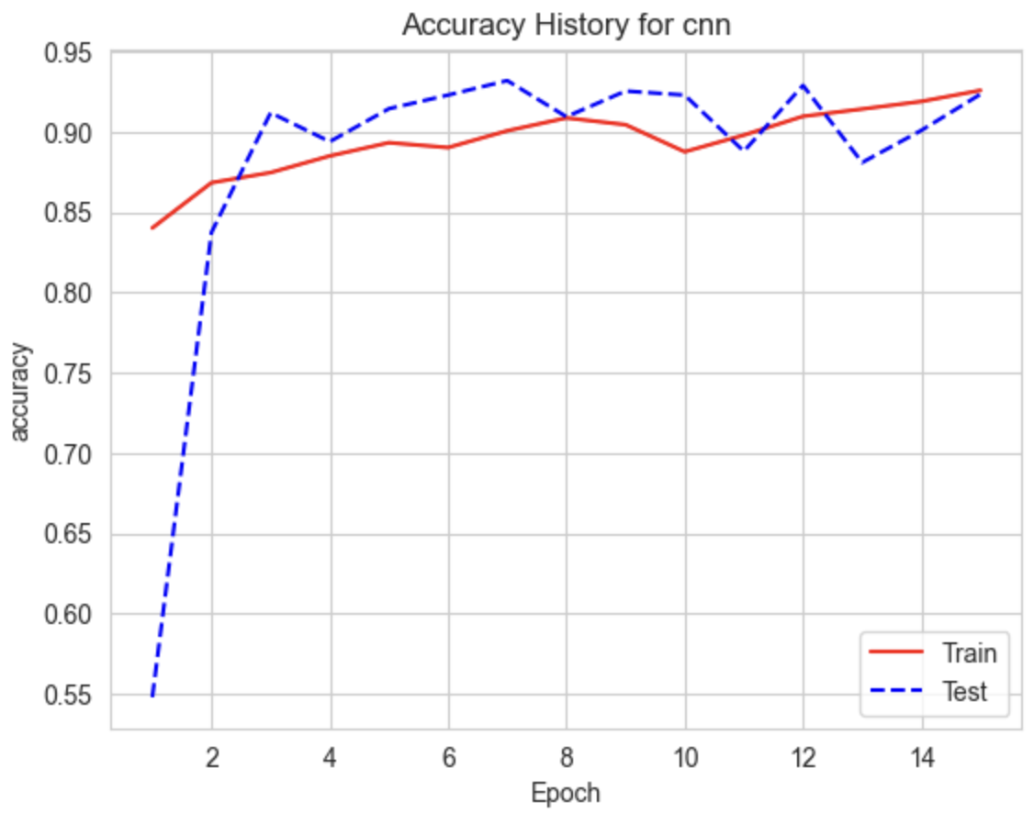
The results:

Slide 11
Final results:
 | Accuracy | Precision | Recall | MSE
Baseline | 50% | 0% | 0% | 0.5
Logistic Regression | 67.85% | 89.40% | 40.50% | 0.32
NN | 83.90% | 91.24% | 75.00% | 0.16
CNN | 92.35% | 92.56% | 92.10% | 0.08

Slide 12
